Slide 1



Sales and Traffic Prediction
Andrew Schleiss
Forecasting of an anonymous US company’s data

Slide 2
PROJECT SUMMARY
APPROACH & METHODOLOGY
Initial Analysis & Auto ML
Pre-Processing
Data Augmentation
Model & Metrics Selection
Training Approach & Optimization
Post Processing & Results
Conclusion
Always be experimenting:
Create code that always for repeated iterations with parameter and variable changes
2

Slide 3
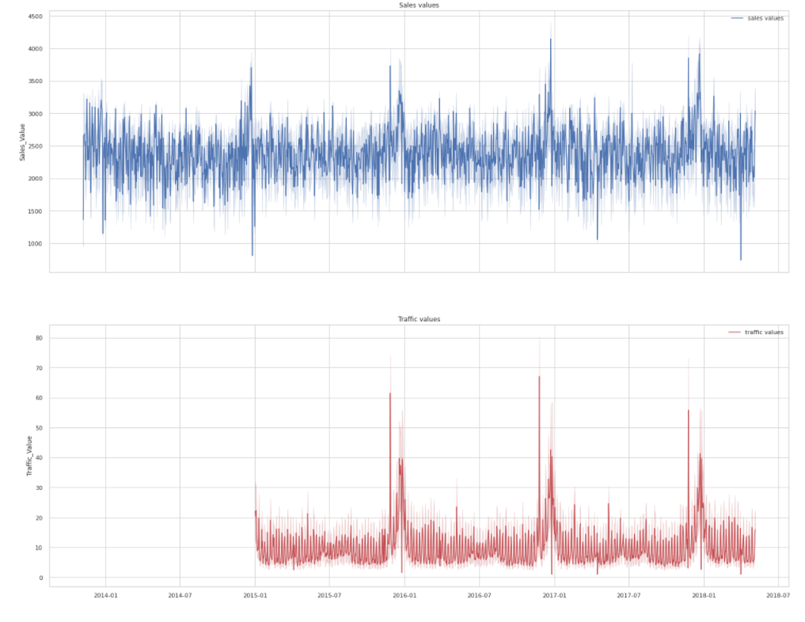
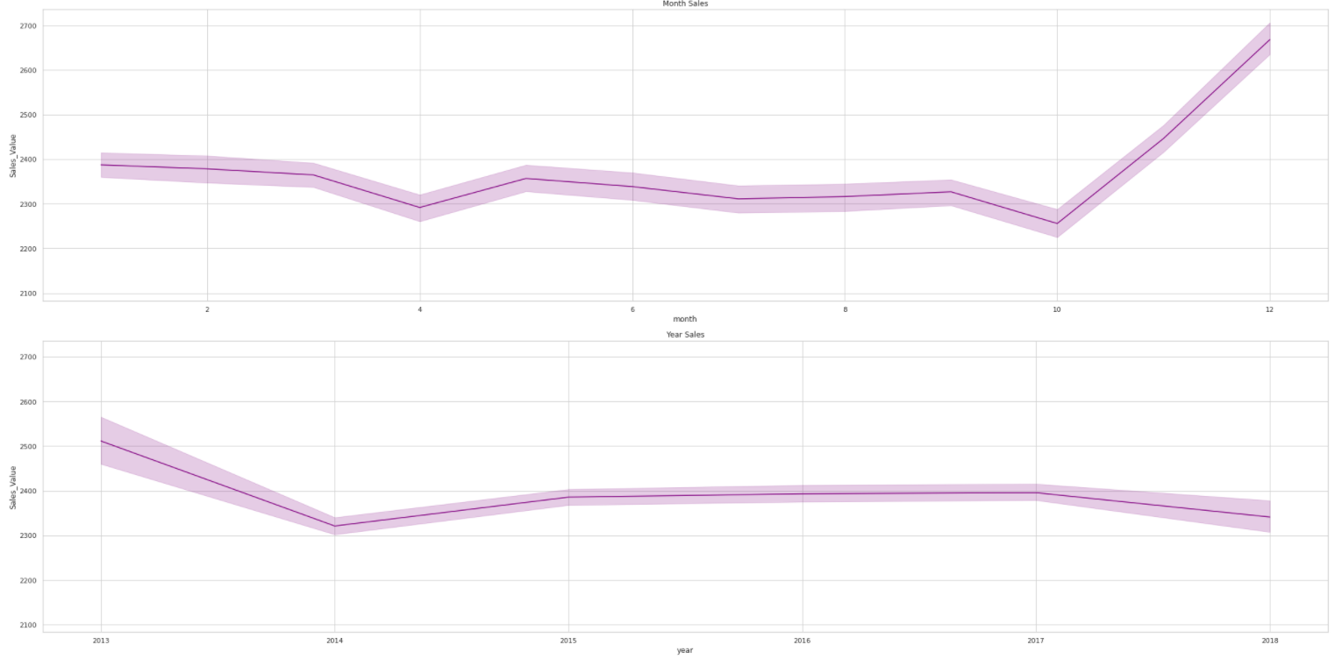
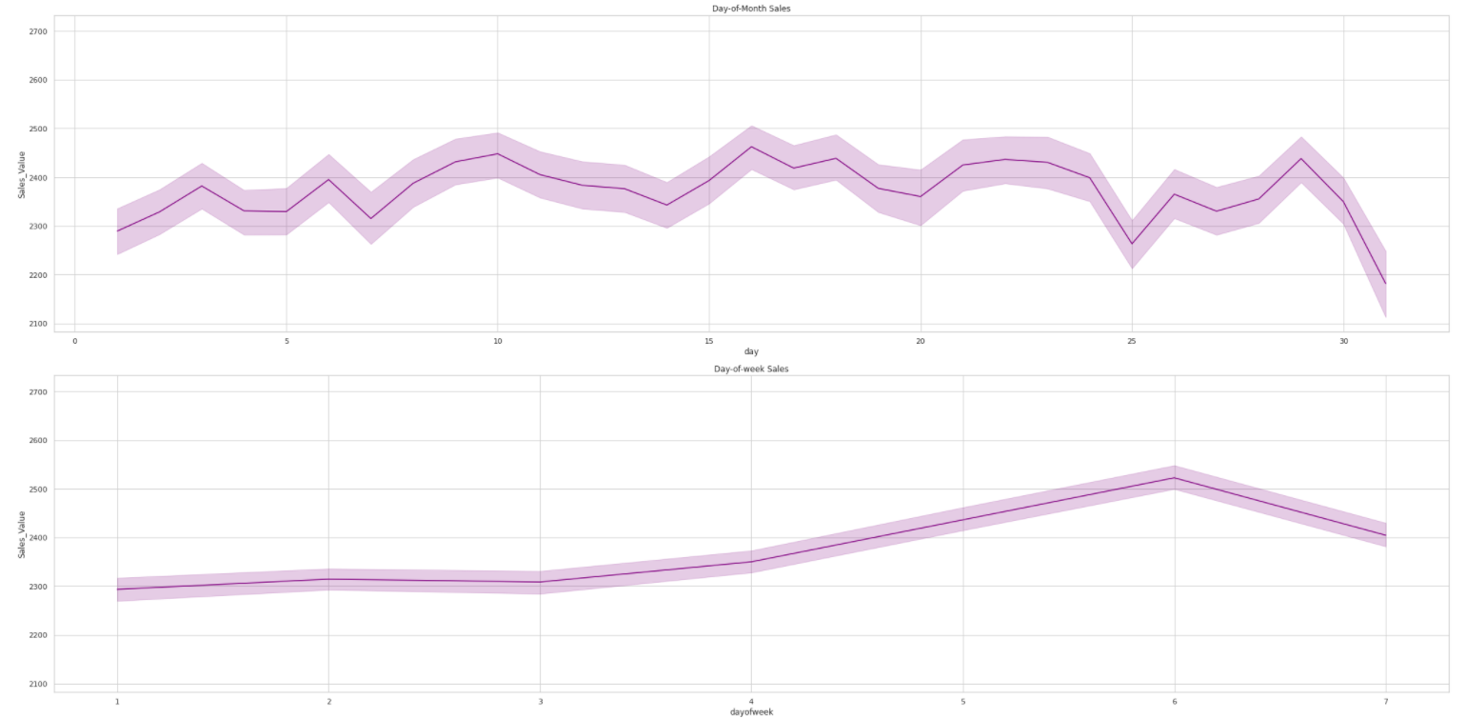
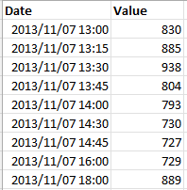
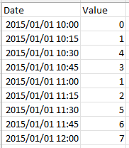
INITIAL ANALYSIS & AUTO-ML
Dataset analysis
15min samples vs 1-hour predictions
Missing values
Date range vs prediction range
Exploratory Analysis:
Day of month
Day of week
Month
year
Basic Feature Extraction:
Day, month, year etc.
Auto-ML Modelling

Slide 4
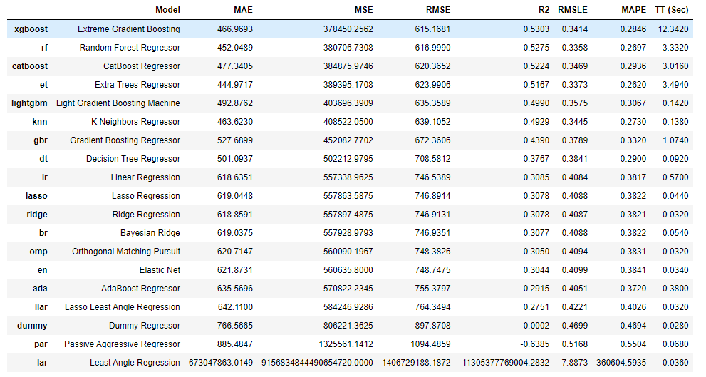
AUTO-ML WITH PYCARET

Slide 5
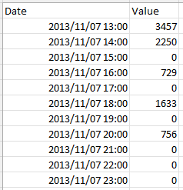
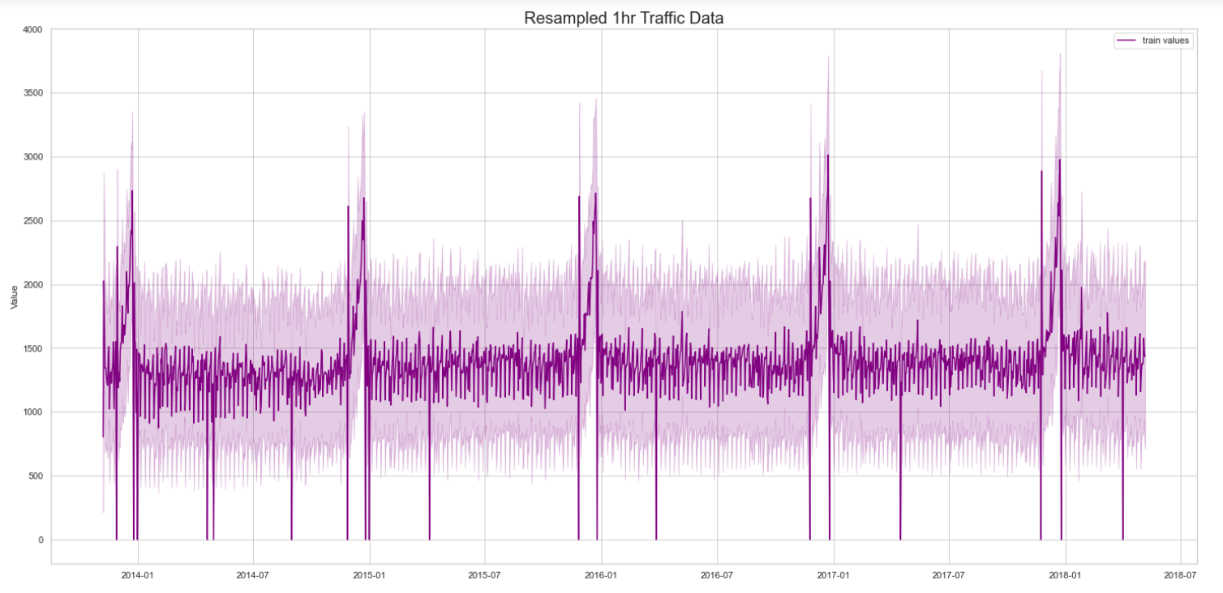
PRE - PROCESSING
Creation of test data – 1 month
Missing values (15min intervals)
Interpolation
Linear | cubic spline
Zero fill
Supervised learning
Resampling with summation of 1hr intervals
Fill in missing intervals with 0’s
Not used
Notes:
Cubic spline uses all the features in its prediction and creates n polynomial lines (spline) through data of polynomial degree 3 (cubic)

Slide 6
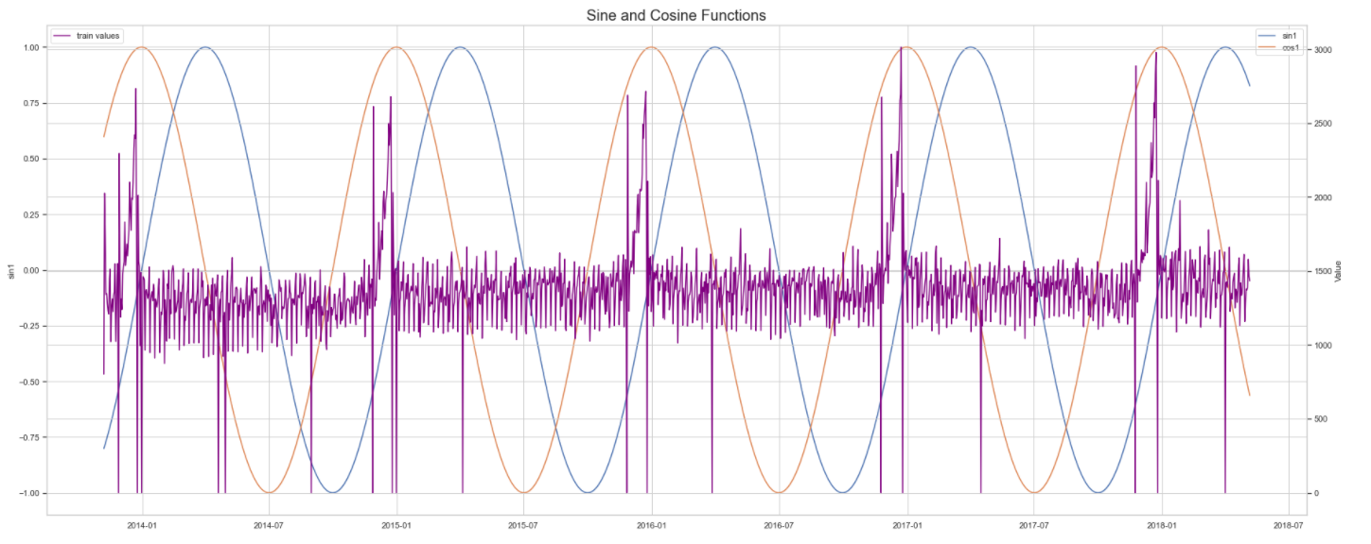
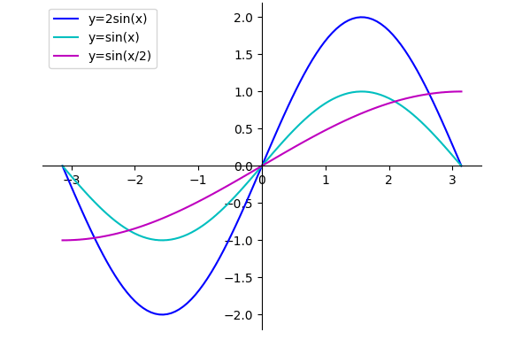
DATA AUGMENTATION
Feature Extraction
Linear (Fourier Transformation) Temporal
Feature | Specifics
Hour
Day
Year
Month Start
Month End
Specific Months | Oct, Nov, Dec, Jan
Week of year
Day of week
Weekend | Saturday and Sunday
Specific Day | Friday
Day of year | Including 2016 leap year
Inverse day of year
Quarter
Days in month
Extracted:
Day of year (20 multiplicative variations)
Month
np.sin(2 * np.pi * f * t)
Day
Hour

Slide 7
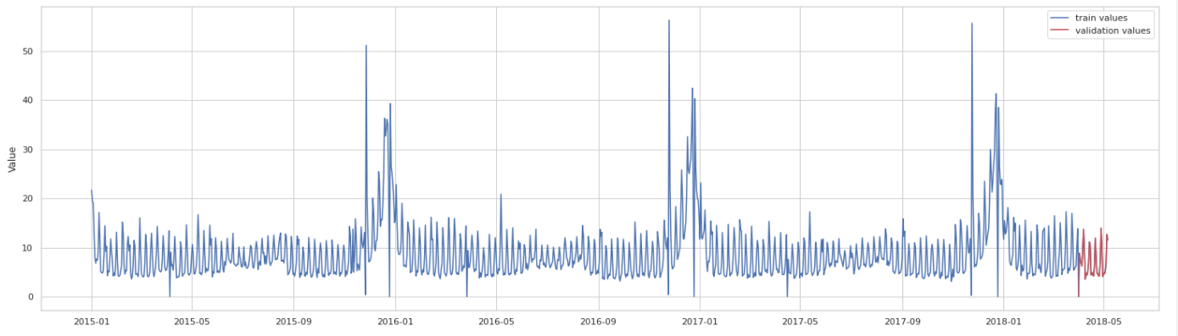
DATA AUGMENTATION
Scaling – Normalization vs Standardization
OneHotEncoding
Train Validation Split Options
Cross validation (time series split)
Hold-out Validation (> 2018-04-01)
Additional data
Gross domestic product (US)
Public (federal) holidays
Calculated “days till next holiday”

Slide 8


MODEL SELECTION
RIDGE
Indicated by Auto-ML
Achieve promising results in recent time series competitions
Interpolate non-linear features
Auto-Tuning with Optuna
Ease of implementation
Interpolate linear features
L2 Regularization
KNN | ANN
Notes:
Lasso – not needed as we iterate through our features
Tweedie and Huber were tested however did not beat Ridge – most likely due to the regularization

Slide 9
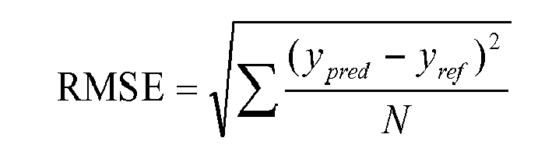
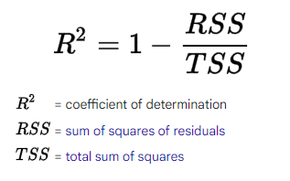
METRIC SELECTION
RMSE
R-squared
Common metrics between LightGBM and Ridge (RMSE)
Specific measure e.g., residual calculation – RMSE
Holistic, easily understood e.g., variance of model vs variance data
RMSE = root mean squared error
y pred = predicted values of target
y ref = actual values of target
N = number of samples
Notes:
Lasso – not needed as we iterate through our features
Tweedie and Huber were tested however did not beat Ridge – most likely due to the regularization
R-squared = 1 – RSS/ TSS
RSS – sum of square residuals sum(y – ypred)**2 -----variation in model
Total sum of squared (features) = sum(x values – mean)**2 --- variation in data

Slide 10
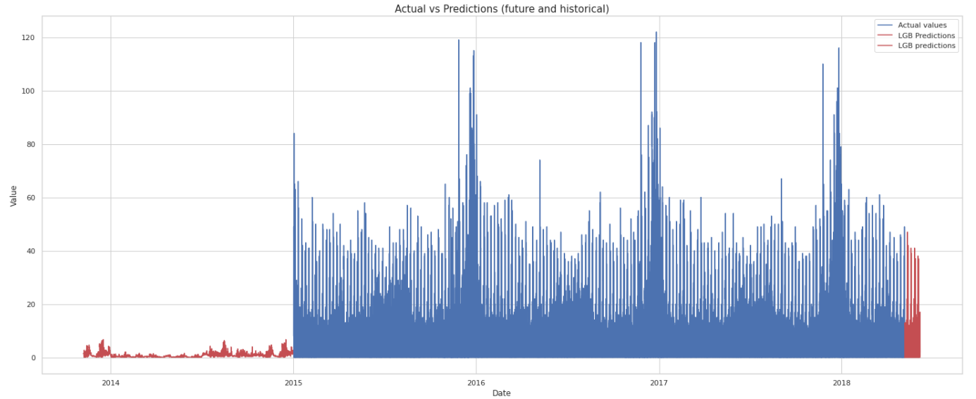
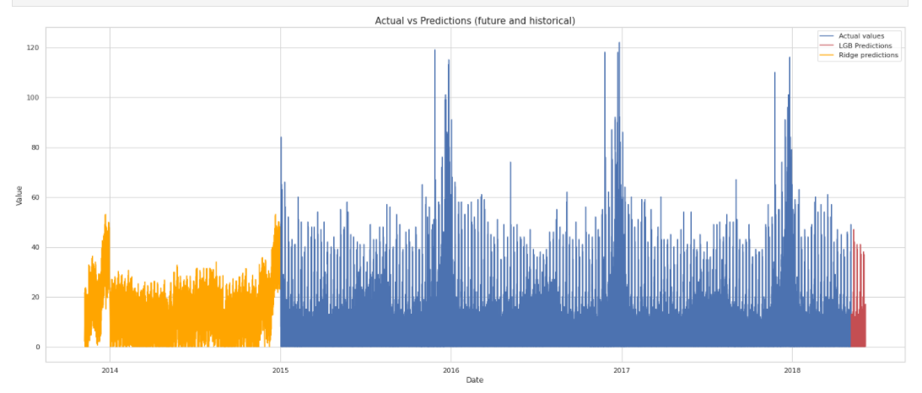
TRAINING APPROACH & OPTIMIZATION
Traffic Modelling Process
Sales Modelling Process
Experiments
Missing values
Parameter Tuning (optimization)
Temporal and Linear Features
Log transformation (Ridge)
Adding public holidays & GDP
Scaling methods – Standard, MinMax or Robust Scaling
Adding Traffic data (Sales prediction only)
Processing
Merge Traffic data
(future, actual & historical)
Historical Data
Future Data
Iterative
Optuna
Ridge prediction
LightGBM prediction
Feature processing
(Actual data)
Optuna
LightGBM prediction
Predict Past
Predict Future
Sales Prediction
Notes:
Optimization:
Lightgbm – Optuna
Ridge – iterative process of regularization param
Experiments:
LightGBM preferred Temporal features | Ridge preferred linear features
Log transformation – fix any skewed distribution of the data

Slide 11
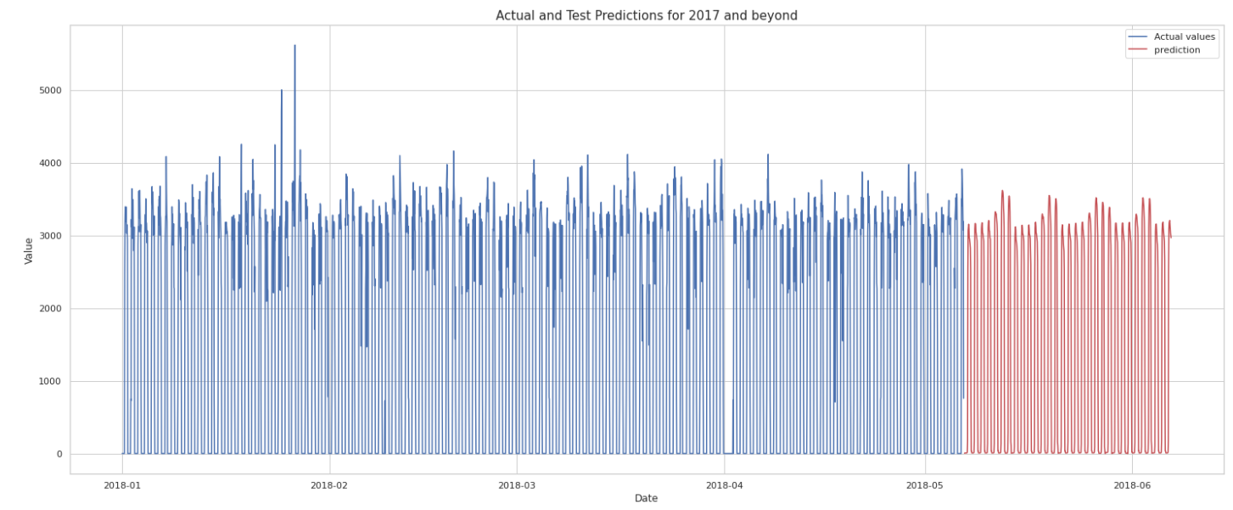
POST-PROCESSING & RESULTS
Validation Results
Data | Model | RMSE | R-Squared
Traffic | LightGBM | 3.56 | 0.87
 | Ridge | 5.95 | 0.65
Sales | LightGBM | 275.92 | 0.97
Sales | Ridge | 608.20 | 0.84
Results
Post Processing
Ensemble techniques
Prediction Processing
Clipping - minimum of 0
Rounding - nearest integer
Ensembling Processing
Geometric mean
Arithmetic mean
Notes:
Results:
LightGBM outperformed Ridge --- due features extracted and additional data???
Geometric mean – is the n root of the multiplicative values ----when values are difference | different scale
Arithmetic mean - arithmetic predicted higher values – so was used as the final submission

Slide 12
CONCLUSION ……….
Further Enhancements / Experiments
Additional features – weather, consumer spending, temperature, seasons, location
Additional models
Ensembling
More submissions
Weighted ensemble
Different metric (Poisson, Adjusted R-Squared….)
Multi-step recursive (shifted values and rolling window)
Train on full data – Ridge only
12
Notes:
KNN - static trend over each year – no upward trend
-- massive seasonality = KNN could be accurate
Poisson metric = y_pred - y_true * log(y_pred)

